Slide 1


Slide 2
Topics Covered
About Variables in Ansible
Host & Group Variables

Slide 3


About Variables in Ansible
Before you start using variables, it’s important to know what are valid variable names.
Variable names should be letters, numbers and underscores.
Variables should always start with a letter.
Example
Valid : foo_port, foo5
Not Valid variable names : foo-port, foo port, foo.port and 12
YAML also supports dictionaries which map keys to values.
Example
Also you can refer specific field in the dictionary using either bracket notation or dot notation.
Example

Slide 4

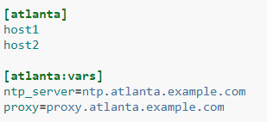
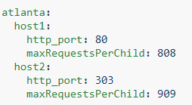
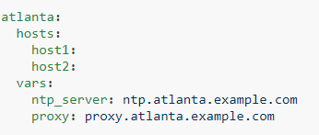
Host and Group variables
Host
Group
Assigning variable to one machine is called host variables.
INI Version :
YAML Version :
Assigning variables to many machines is called group variables.
INI Version :
YAML Version :

Slide 5
End…

